Slide 1
AI SUMMIT 2026
BY- Ayantika Gangopadhyay
Prionti Majumder
New Delhi, India (17th Feb 2026-18th Feb 2026)

Slide 2
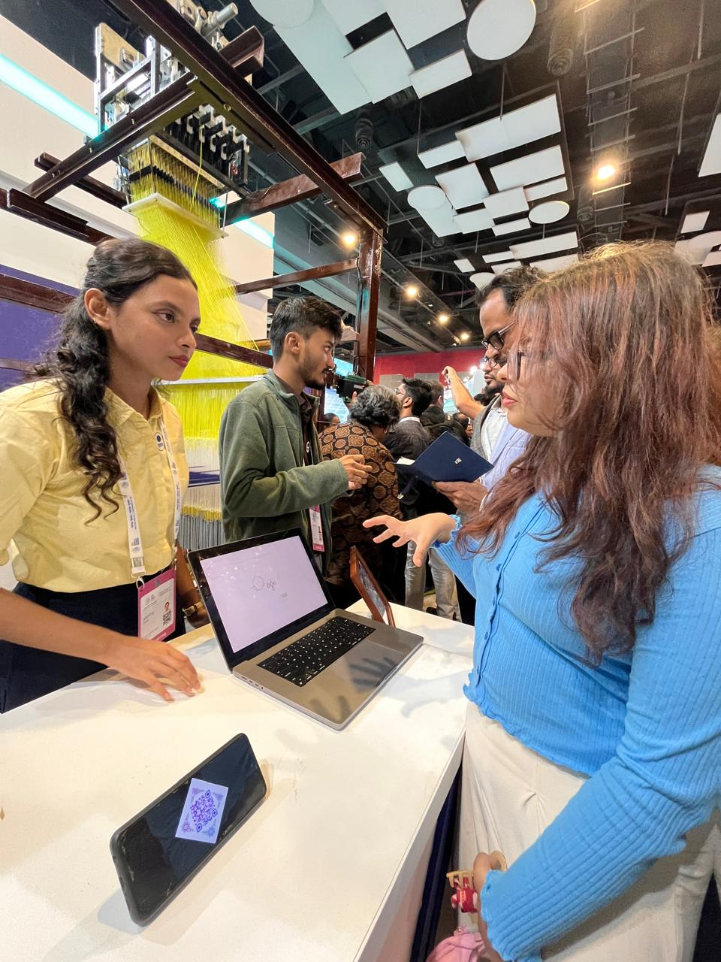
TCS – Saree Print Design using AI (Hall 2)
Organization: Tata Consultancy Services
AI-powered textile design generation system
Uses Generative AI & Computer Vision to create saree patterns
Trained on traditional Indian motifs (Banarasi, Kanjeevaram, etc.)
Designers can:
Input color preferences
Select pattern styles
Generate multiple design variations instantly
Reduces manual design time
Helps preserve cultural heritage using digital archives
Supports sustainable fashion by minimizing sampling waste
Example of AI + Creativity in the fashion industry

Slide 3
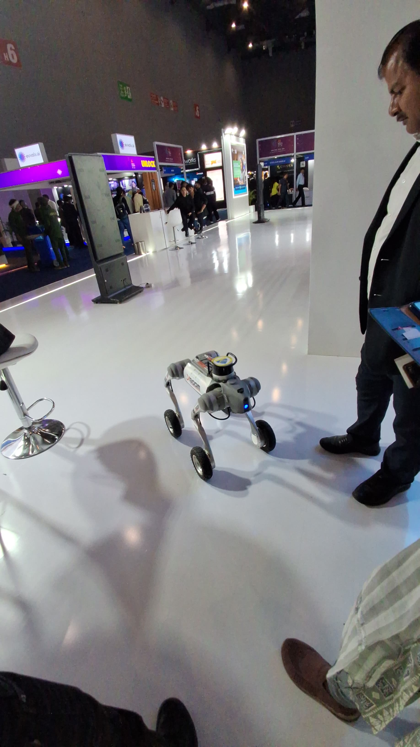
IPL Robotics Dog (Hall 4)
AI-powered quadruped robotic dog
Used in sports events like Indian Premier League
Capabilities:
Autonomous walking & obstacle detection
Live camera streaming
Player interaction
Built using:
Computer Vision
Reinforcement Learning
Motion planning algorithms
Applications:
Sports broadcasting
Security surveillance
Disaster rescue operations
Demonstrates AI + Robotics integration

Slide 4
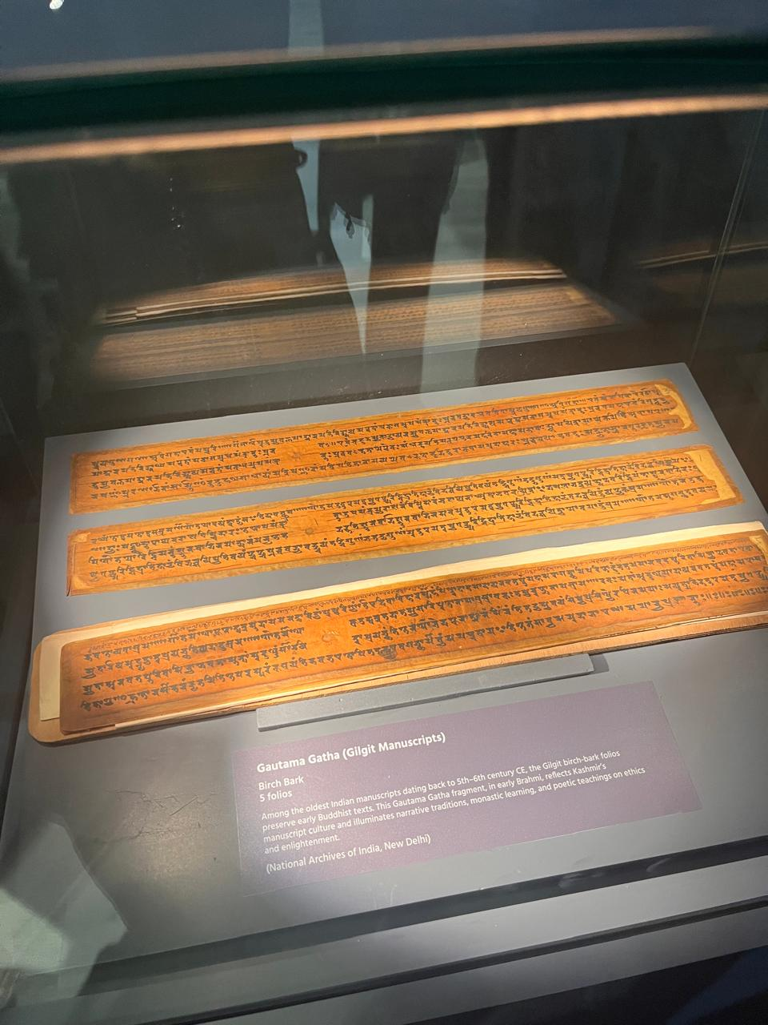
Manirishi Manuscript – Gyanbharatam (Hall 14)
AI-based ancient manuscript digitization project
Focus on Indian knowledge systems
Converts old Sanskrit texts into digital format
Uses:
OCR (Optical Character Recognition)
NLP for translation & summarization
Makes rare manuscripts searchable
Preserves cultural and historical heritage
Supports research & education
Bridges traditional knowledge with modern AI

Slide 5
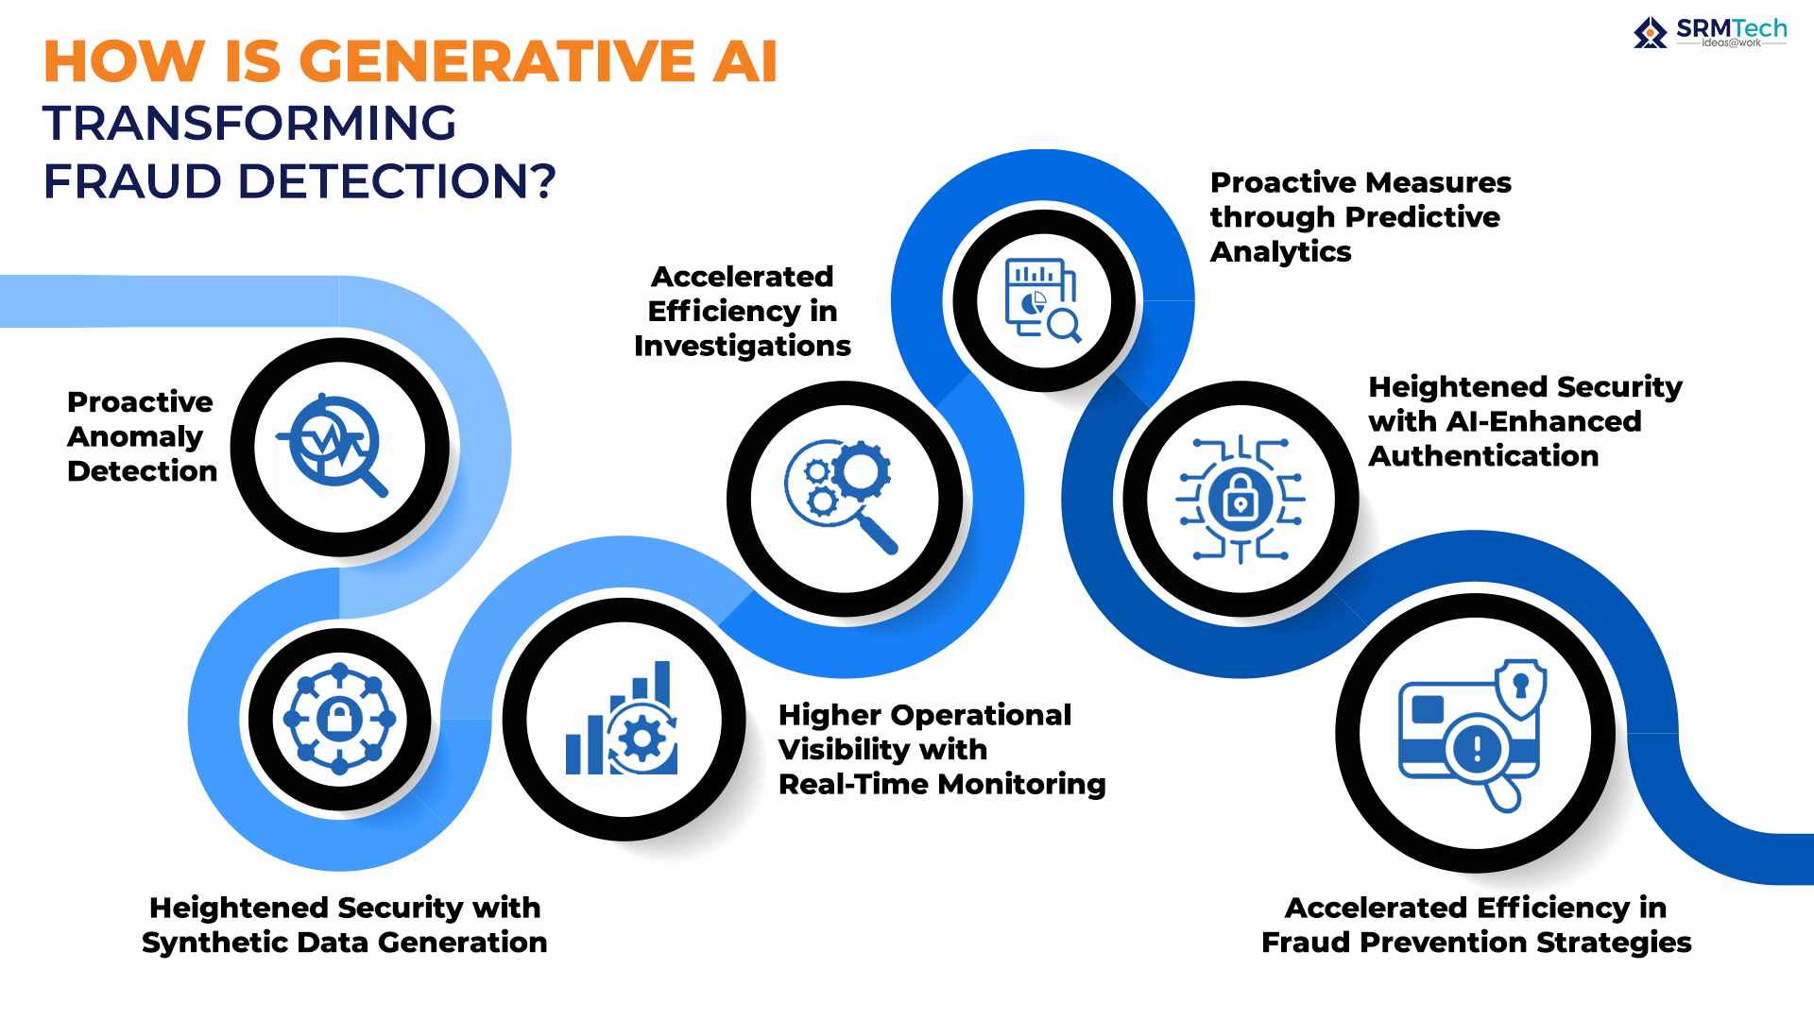
Next-Gen AI Fraud Detection in UPI (Hall 3)
AI system for fraud detection in UPI payments
Monitors real-time transaction patterns
Uses:
Machine Learning models
Behavioral analysis
Anomaly detection algorithms
Detects:
Suspicious transactions
Unusual login locations
Fake accounts
Reduces financial fraud risks
Improves trust in digital payments ecosystem
Enhances cybersecurity in fintech

Slide 6
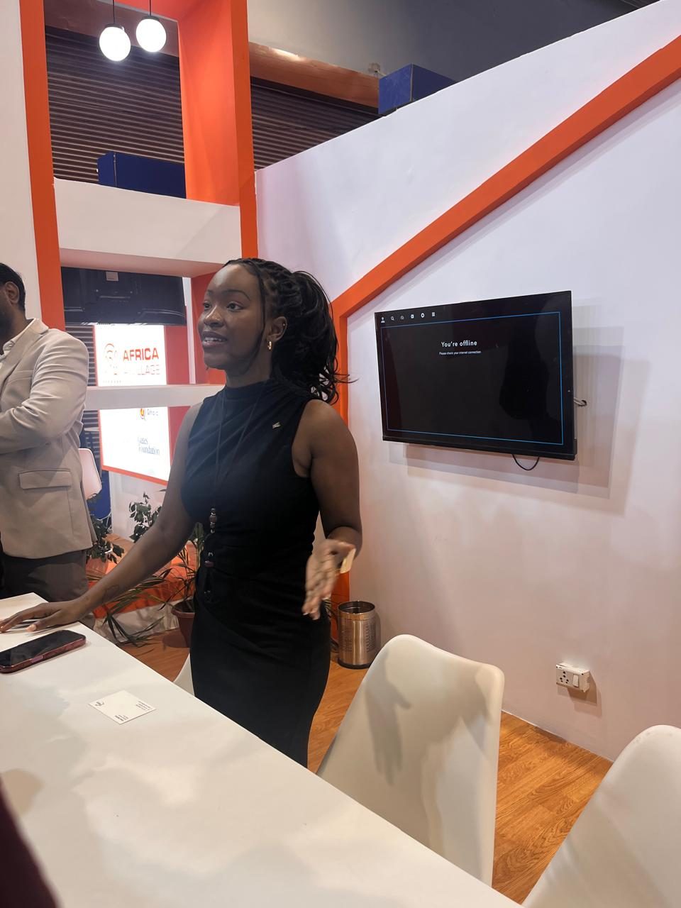
African AI Village (Hall 14)
Dedicated pavilion showcasing African AI innovations
Focus areas:
AI in agriculture
Healthcare diagnostics
Financial inclusion
Use of AI for:
Crop monitoring
Disease prediction
Mobile banking security
Encourages global AI collaboration
Promotes inclusive AI development
Highlights AI’s role in emerging economies

Slide 7
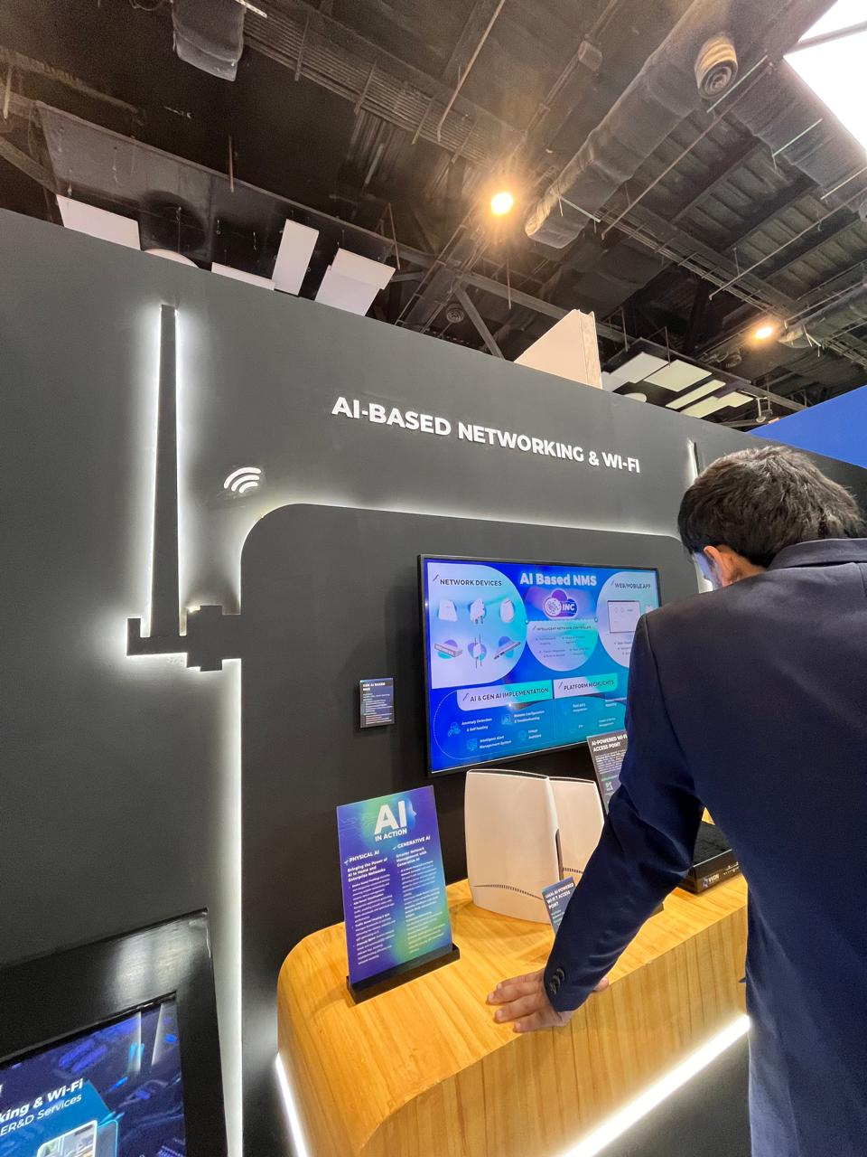
AI-Based Networking & Smart WiFi (Hall 4)
Intelligent network optimization using AI
AI automatically:
Detects network congestion
Adjusts bandwidth allocation
Improves signal strength
Uses:
Predictive analytics
Self-healing networks
Reduces downtime
Enhances user experience
Important for 5G & IoT environments

Slide 8
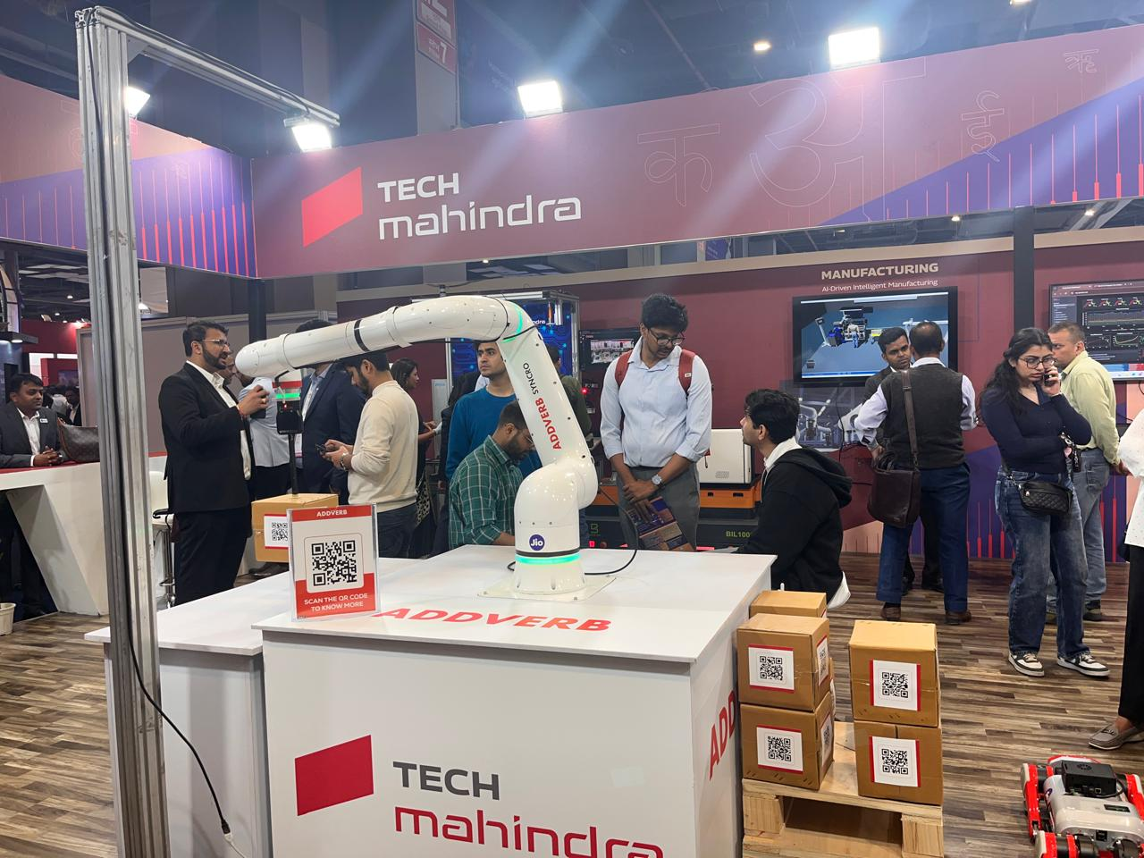
AI-Driven Intelligent Manufacturing – Tech Mahindra (Hall 2)
Company: Tech Mahindra
Smart factory solutions powered by AI
Uses:
Predictive maintenance
Computer vision for defect detection
IoT sensor integration
Benefits:
Reduced machine downtime
Increased production efficiency
Cost optimization
Real-time data analytics dashboard
Supports Industry 4.0 transformation

Slide 9
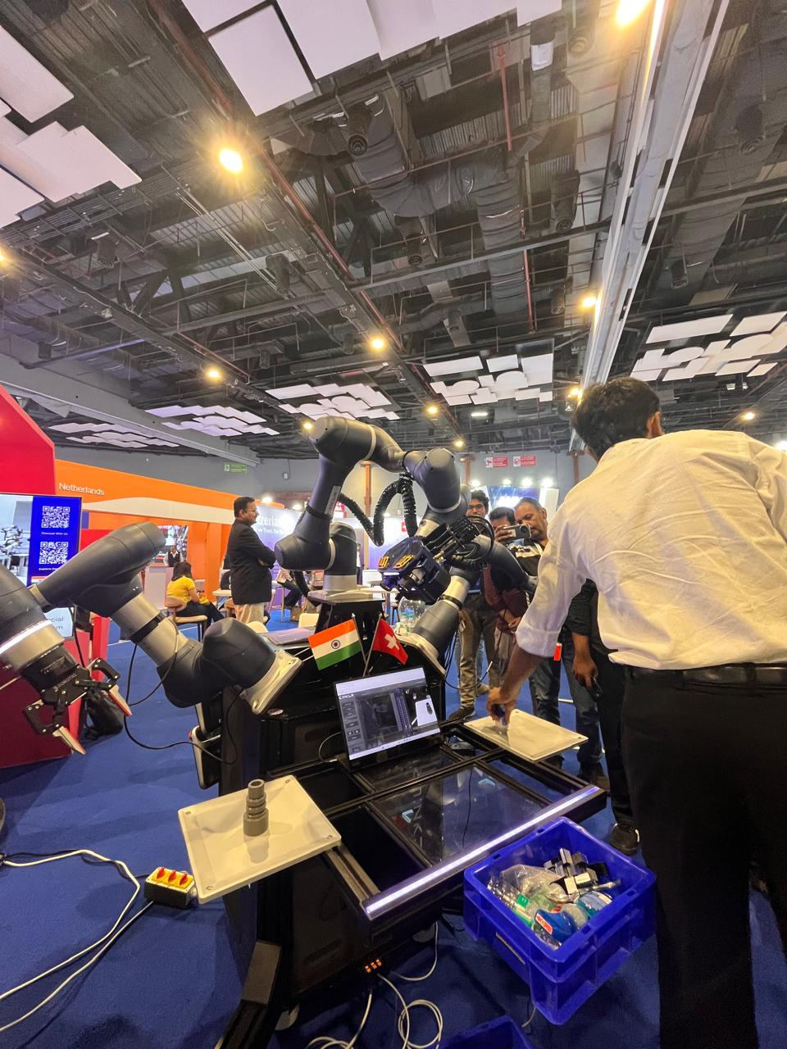
Reinforcement Learning – Robot Hand (Hall 3)
AI-controlled robotic hand
Uses Reinforcement Learning (RL)
Learns by:
Trial and error
Reward-based feedback
Can:
Pick and place objects
Adjust grip strength
Recognize object shapes
Applications:
Prosthetics
Automation
Precision manufacturing
Demonstrates advanced robotics intelligence

Slide 10
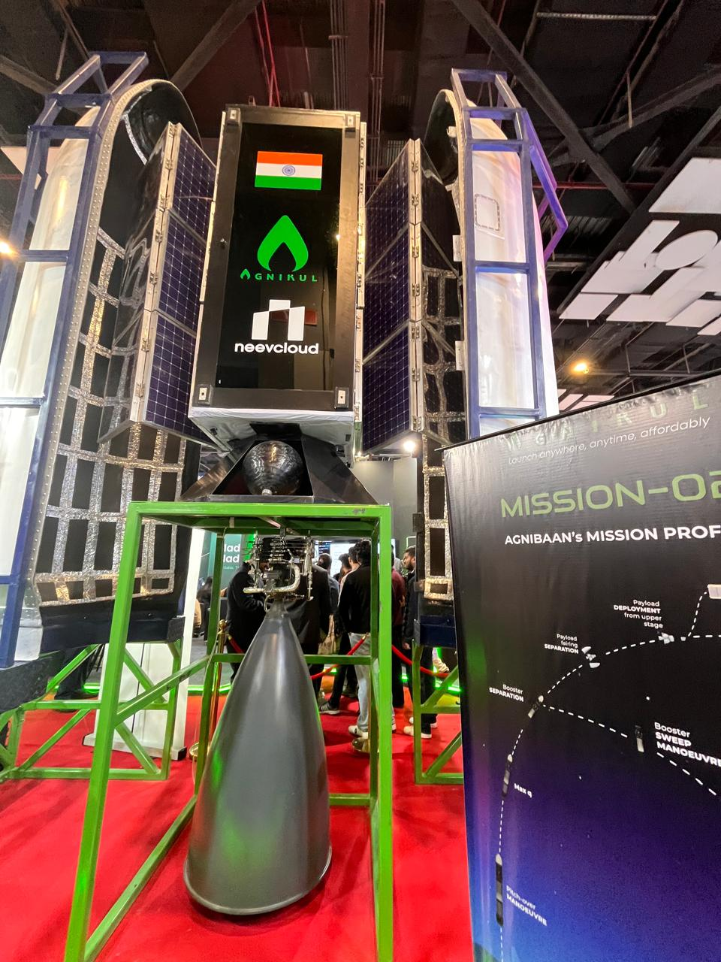
AI Inference from Orbit (Hall 5)
AI models deployed on satellites
Performs real-time data analysis in space
Uses:
Edge AI
Satellite imaging
Applications:
Climate monitoring
Disaster detection
Border surveillance
Reduces need to send raw data to Earth
Faster decision-making
Important for space-tech innovation

Slide 11
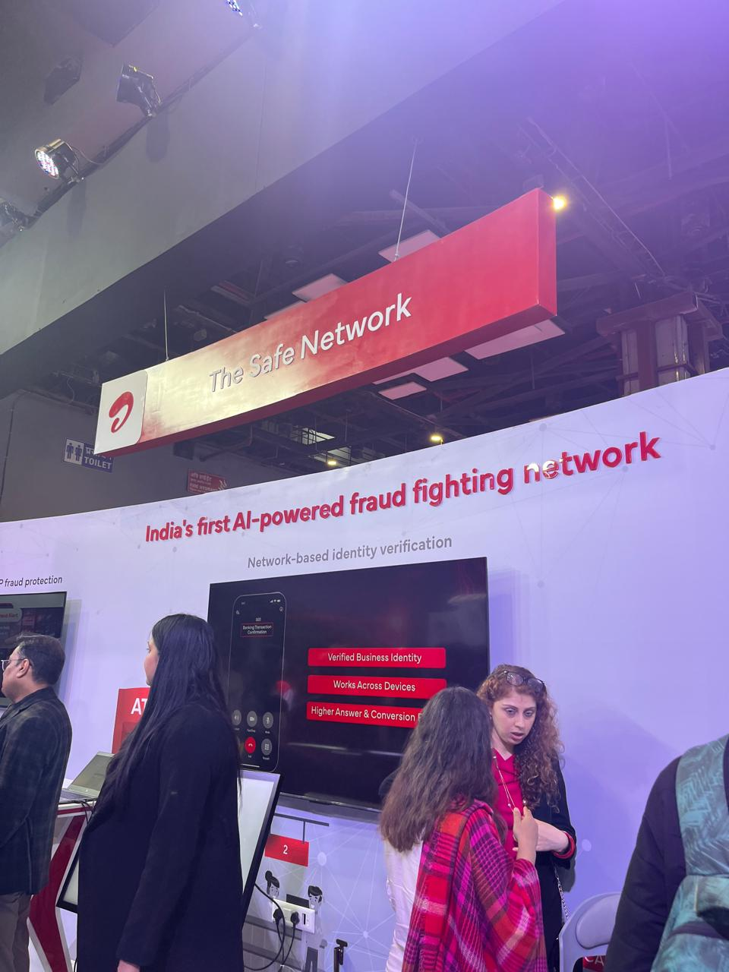
AI Fraud Detection – Airtel (Hall 4)
Company: Bharti Airtel
AI-based telecom fraud detection system
Detects:
SIM swap fraud
Spam calls
Phishing attempts
Uses:
Machine learning models
Real-time call data analysis
Pattern recognition
Improves customer safety
Strengthens telecom cybersecurity
Enhances digital trust

Slide 12
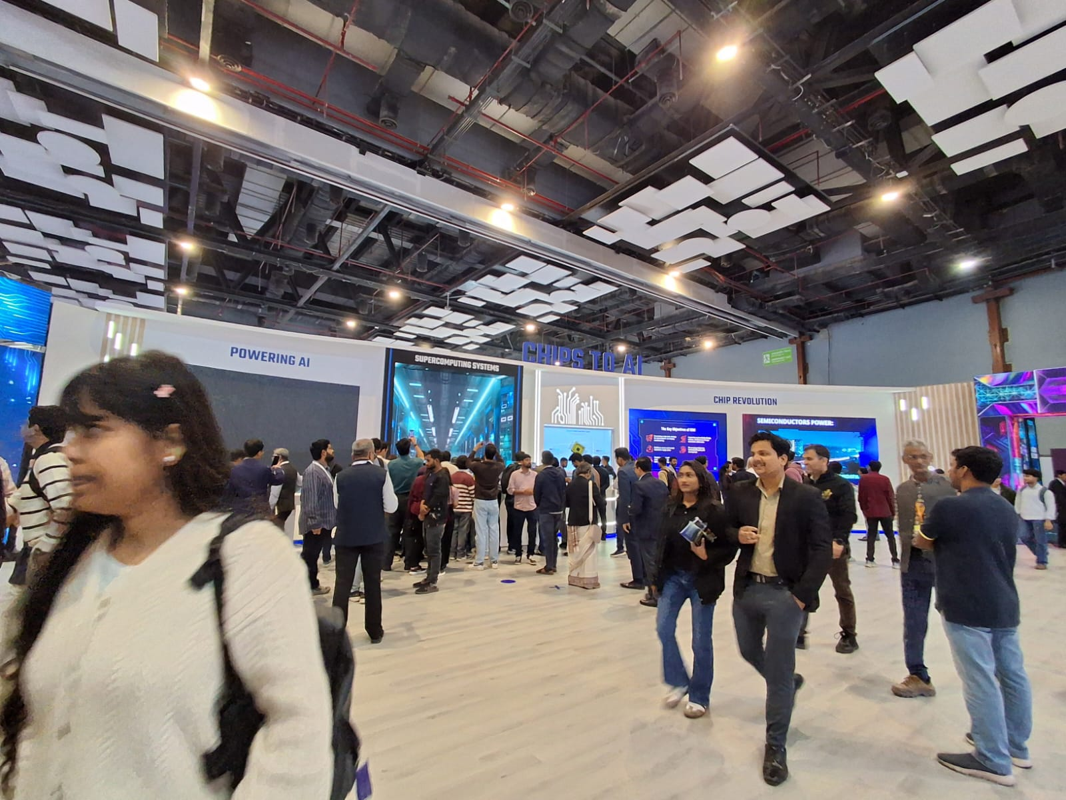
Chip Revolution(Hall 3)
Evolution from traditional CPUs to AI-specific chips
Includes:
GPUs
TPUs
NPUs (Neural Processing Units)
Focus on:
Energy efficiency
Faster AI inference
Edge computing support
Smaller node sizes (5nm, 3nm technology)
Supports AI in smartphones, IoT, autonomous vehicles
Key driver of modern AI transformation

Slide 13
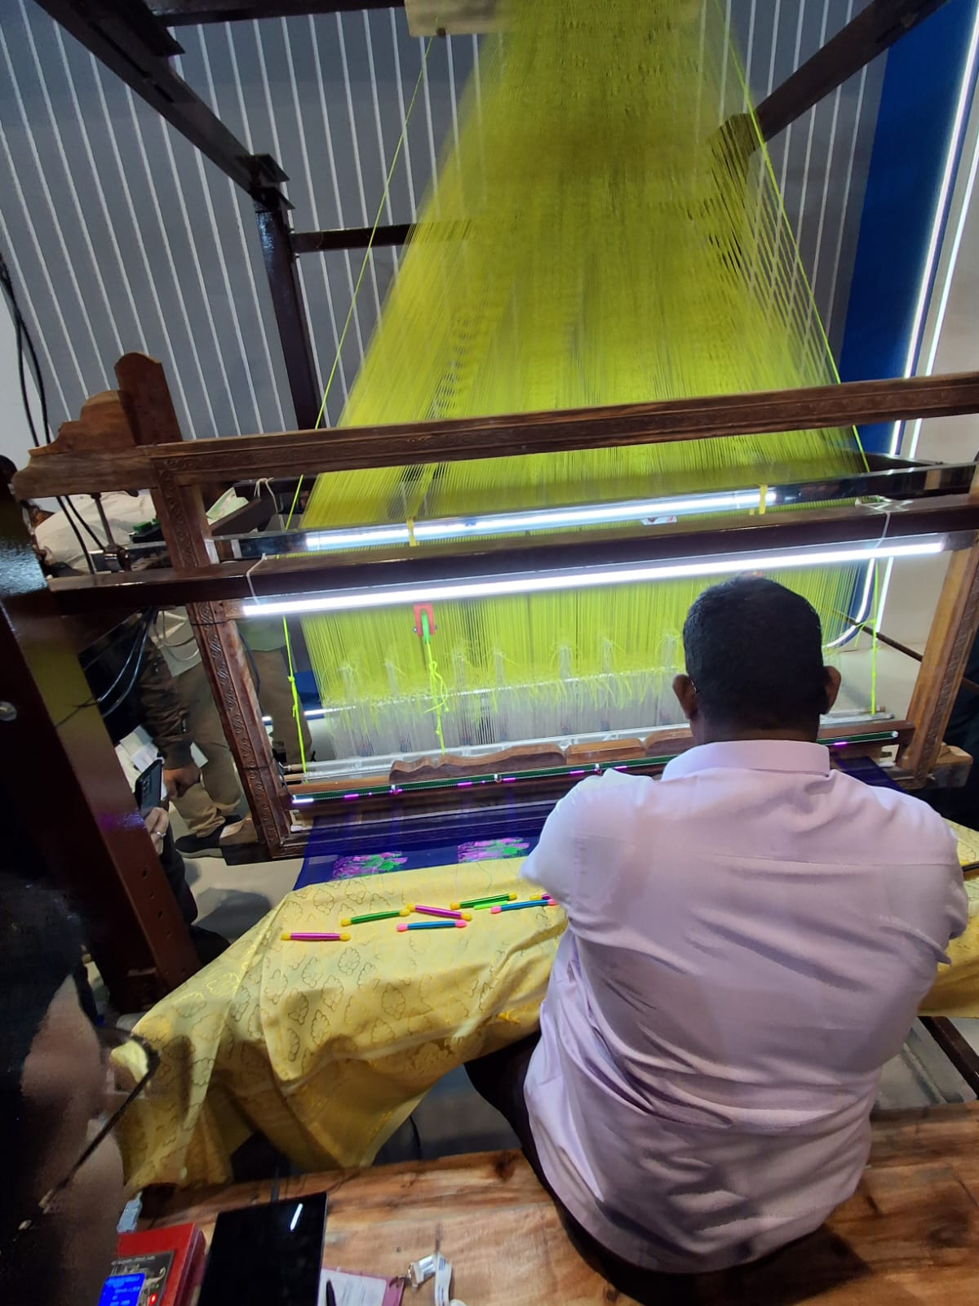
Brigital Loom(Hall 14)
Combination of “Bharat + Digital” textile innovation
AI-powered smart weaving system
Uses:
Pattern automation
Design simulation
Color optimization algorithms
Helps traditional artisans adopt digital tools
Reduces manual errors in weaving
Increases production efficiency
Example of AI in rural & MSME empowerment

Slide 14
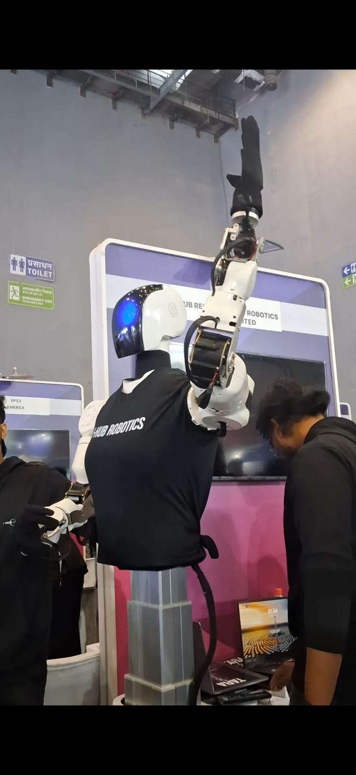
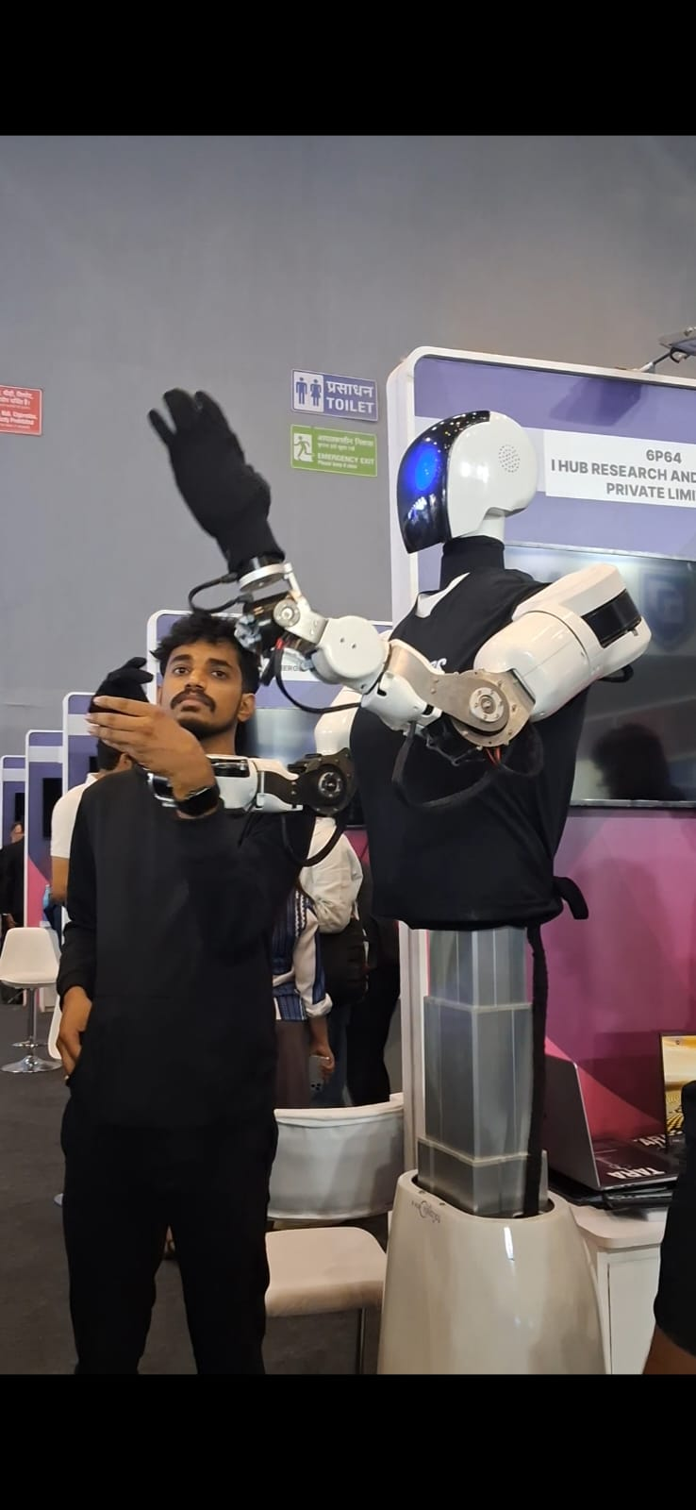
Dancing Robot(Hall 4)
AI-enabled humanoid robot performing dance moves
Uses:
Motion planning algorithms
Real-time balance correction
Sensor fusion (gyro + accelerometer)
Learns choreography using Machine Learning
Applications:
Events & exhibitions
Education
Robotics research

Slide 15
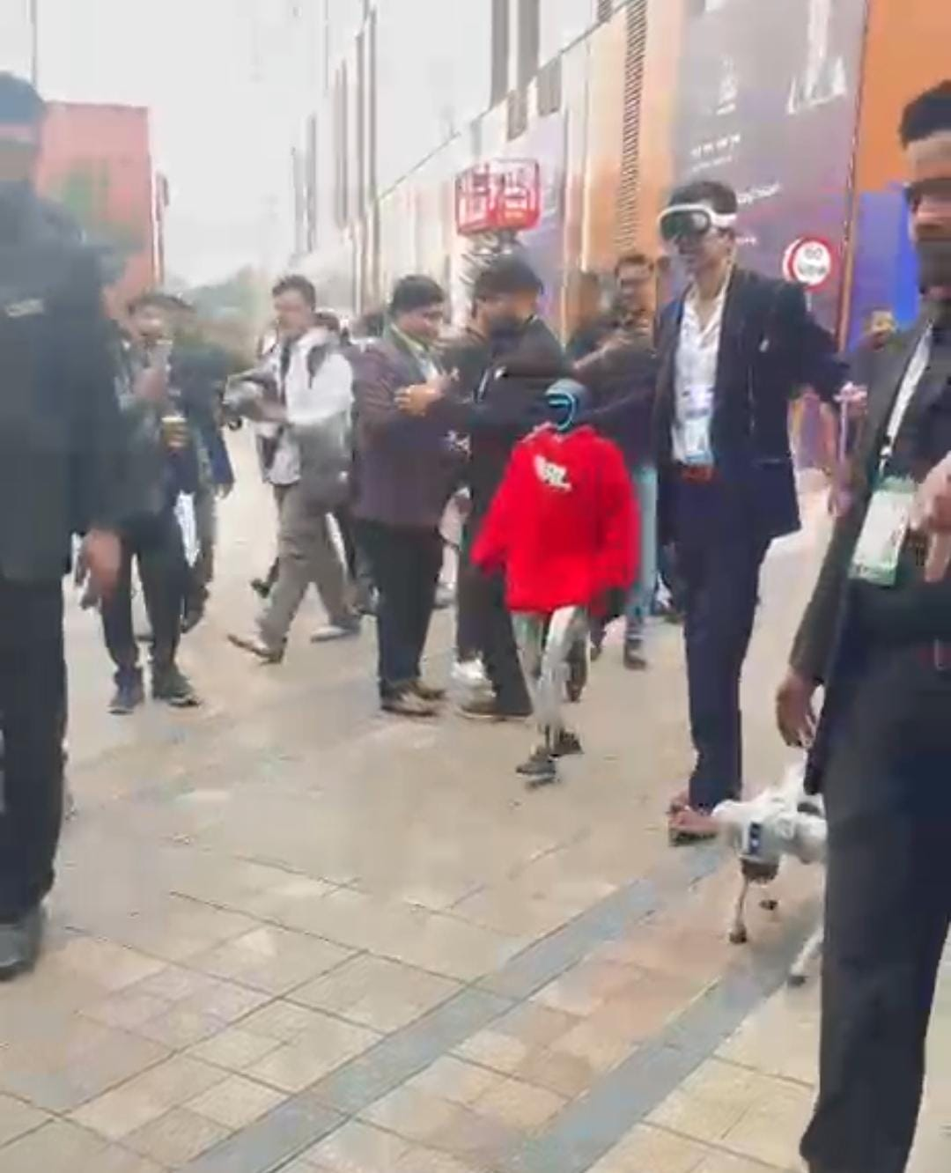
Walking Baby Robot -Red Hoodie(Hall 1)
Small humanoid robot designed like a baby
Demonstrates advanced walking stability
Uses:
Reinforcement Learning
Balance control systems
Real-time environment sensing
Capable of:
Walking independently
Avoiding obstacle
Research applications:
Bipedal robotics
AI locomotion systems
Shows progress in human-like robot movement

Slide 16
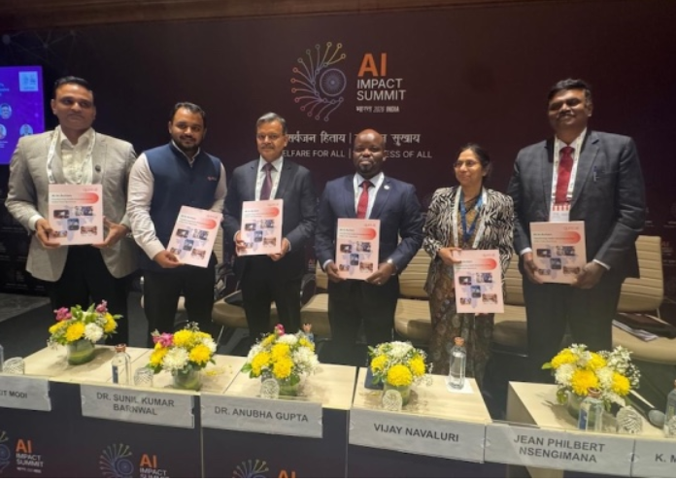
Qure.ai(Hall 4)
Healthcare AI company based in India
Uses AI for medical image analysis
Detects:
Tuberculosis
Lung cancer
Brain injuries (CT scans)
Uses Deep Learning (CNN models)
Helps radiologists with faster diagnosis
Improves healthcare access in rural areas
Reduces diagnostic errors

Slide 17
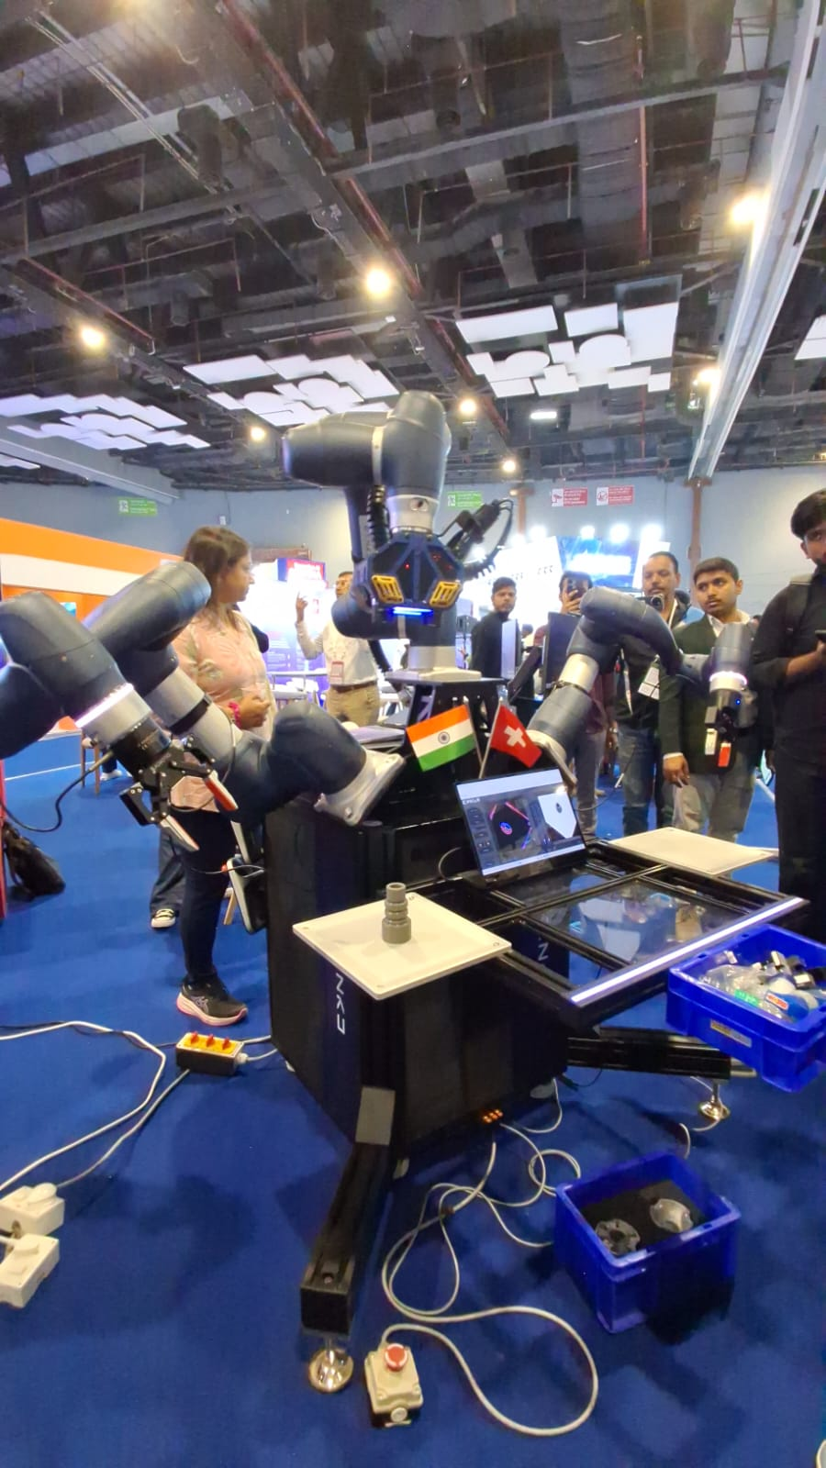
Semi-Humanoid Robot (Hall 4)
Robot with partial human-like structure
Features:
Head & arms similar to humans
Wheeled or fixed lower body
Uses:
AI-based speech recognition
Facial recognition
Gesture detection
Applications:
Customer service
Hospital assistance
Reception & hospitality
Enhances human-robot collaboration

Slide 18
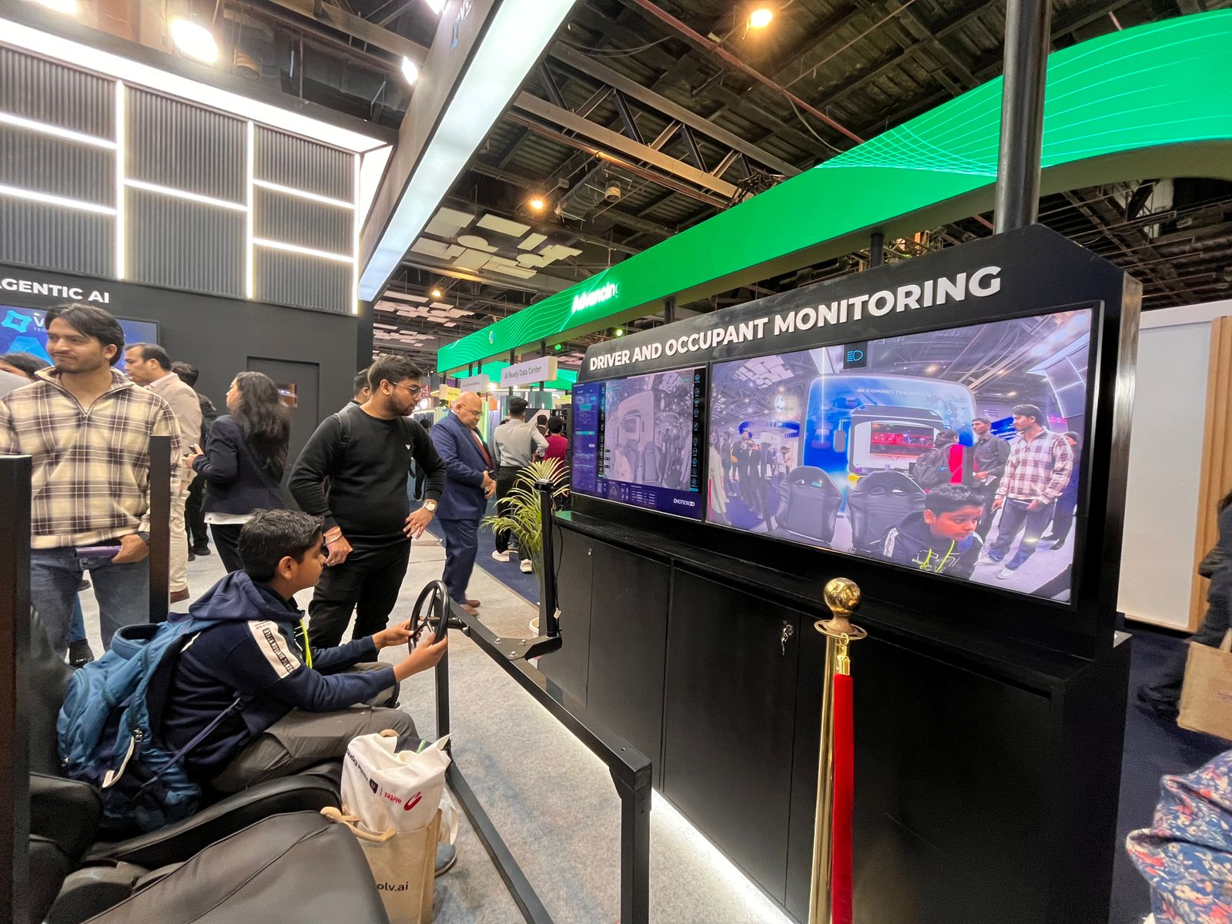
AI Connected Mobility(Hall 3)
Smart transportation powered by AI
Includes:
Autonomous vehicles
Smart traffic management
Vehicle-to-vehicle communication
Uses:
Computer vision
Sensor data fusion
Predictive analytics
Benefits:
Reduced accidents
Optimised traffic flow
Lower fuel consumption
Key component of smart cities

Slide 19
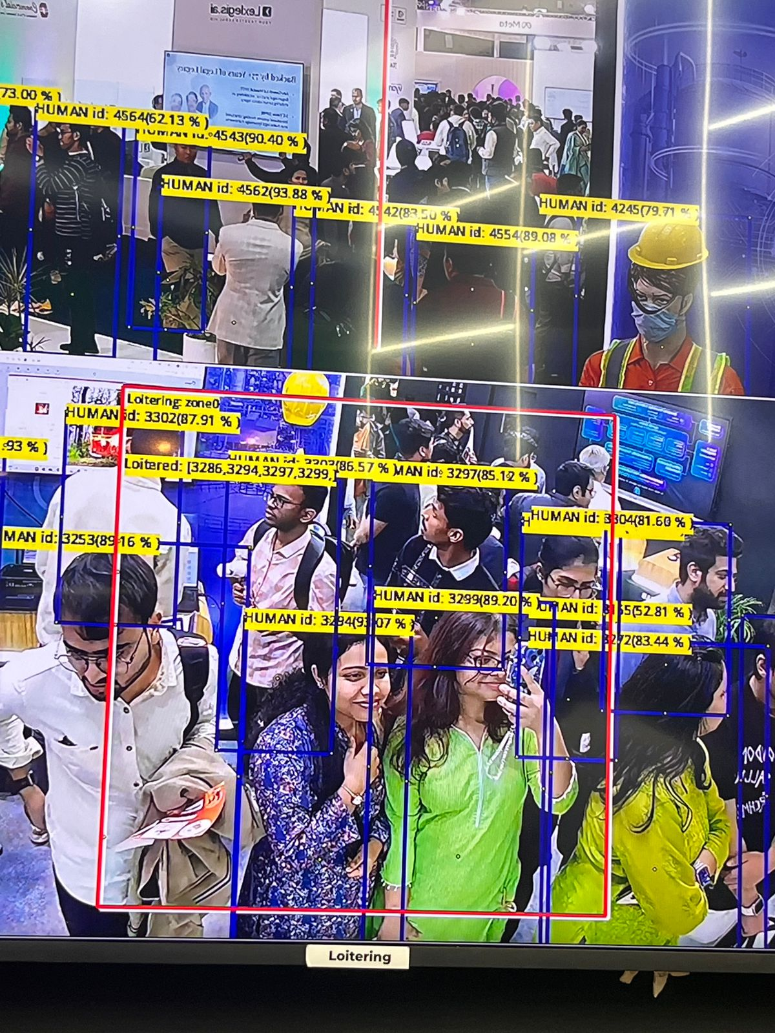
Edge AI Vision(Hall 3)
AI models deployed directly on edge devices
Processes data locally (no cloud dependency)
Used in:
CCTV cameras
Drones
Smart devices
Features:
Real-time object detection
Low latency processing
Improved privacy
Reduces bandwidth usage
Important for IoT & surveillance systems

Slide 20
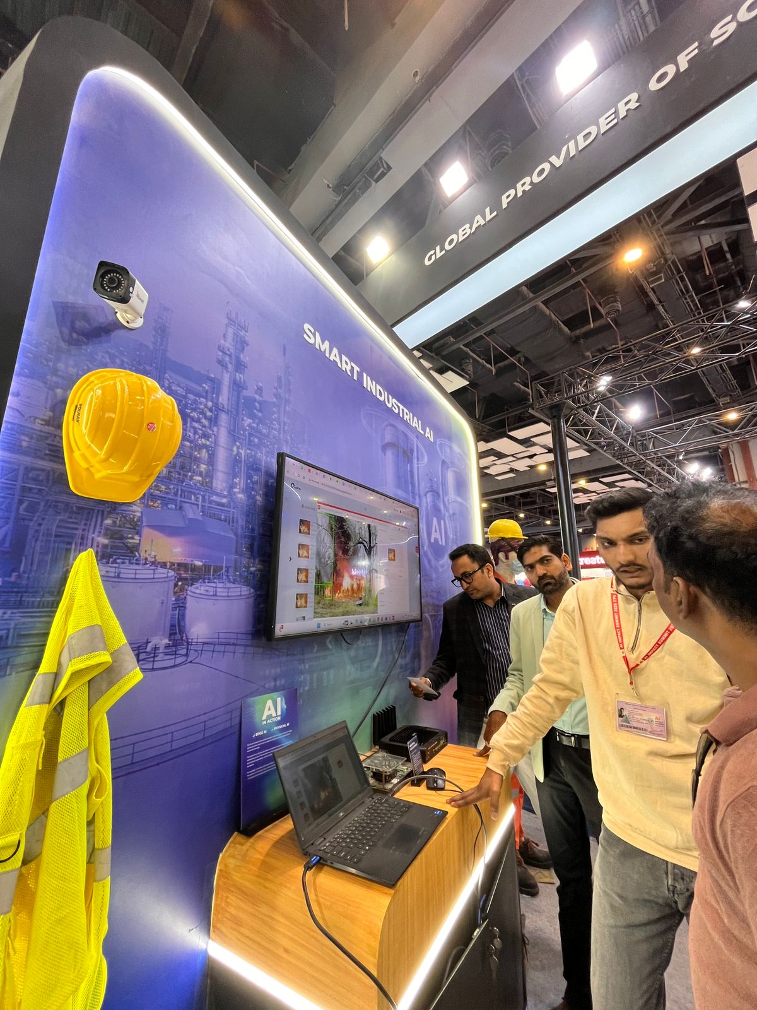
Smart Industrial AI(Hall 3)
AI-powered industrial automation systems
Uses:
Predictive maintenance
Computer vision inspection
Robotics automation
Real-time monitoring of machines
Reduces downtime
Improves production quality
Supports Industry 4.0
Increases operational efficiency

Slide 21
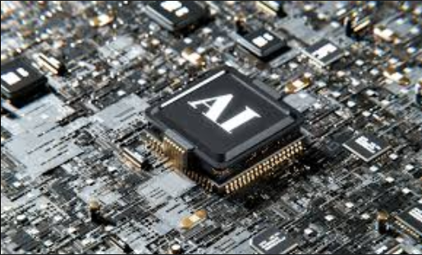
Super Computing Chip(Hall 4)
Uses:
Training advanced AI and machine learning models
Scientific research like climate and space simulations
Large-scale data processing in healthcare and finance
Conclusion:
Enables extremely fast and powerful computation
Essential for AI and technological innovation
Supports national growth and digital transformation

